Slide 1
Find Me
Chiranthan Mirle - 1001011399
Abhishek Agarwal - 1000987331
Ranjith M A - 1000969864
Ather Mohammed - 1000993284
Bhavana Nandyala - 1000859140

Slide 2
Vision
To build an interactive, new generation search assistant which helps us find people and places through the touch of a button.

Slide 3
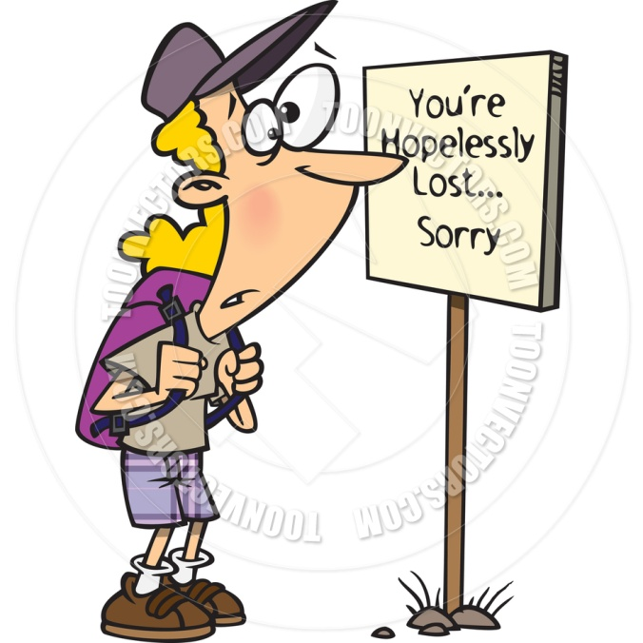
Where am I?

Slide 4

Where's my friend?

Slide 5

Solutions to the problems
To reach a destination you need two parameters

Slide 6

Direction
To know where you are and to proceed to your destination

Slide 7

Distance
After learning the direction, how far should you travel in that particular direction?

Slide 8
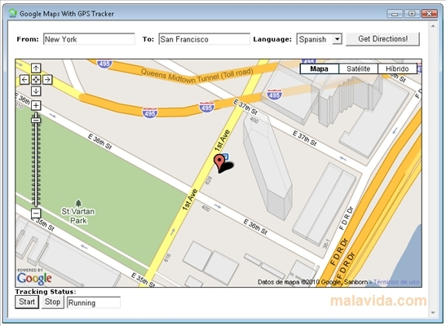

COMPETITORS
GPS
ACROSSAIR

Slide 9
FUTURE SCOPE
New students can explore!
Can go global.

